Slide 1

32555 – Fundamentals of Software Development

Slide 2
Welcome to 32555 – Fundamentals of Software Development
Your Teaching Team:
Dr. Yining Hu | Subject Coordinator
Yining is a Lecturer in Software Engineering. She works with many SMEs to develop software and AI solutions through student and research projects at UTS.
Contact: yining.hu@uts.edu.au
Dr. Xiaojie (Zoe) Lin | Tutor
Zoe is a full-stack software engineer with an interest in data analysis, specializing in JAVA, R, Python, JavaScript, PHP, Bash, and MATLAB; familiar with AWS.
Contact: Xiaojie.Lin@uts.edu.au
Dr. Farshid Keivanian | Tutor
Dr. Farshid Keivanian is an experienced university lecturer and researcher with a PhD in Information Technology. He has over 15 years of teaching experience across Australian institutions, specialising in software engineering, data science, AI, and cybersecurity.
Contact: Farshid.Keivanian@uts.edu.au
Yong Pov | Tutor
Yong is a full-stack software engineer with experience in React, JavaScript, TypeScript, Java, Python, SQL, and AI-assisted learning platforms.
Contact: Yong.Pov@uts.edu.au

Slide 3
Welcome to 32555 – Fundamentals of Software Development
Cmp1 # | Location | Time | Tutor
01 | CB11.B1.400 | Fri 16:00-18:00 | Xiaojie (Zoe) Lin
07 | CB11.B1.401 | Wed 10:00-12:00 | Farshid Keivanian
08 | CB11.B1.400 | Fri 12:00-14:00 | Yong Pov
09 | CB11.B1.103 | Wed 16:00-18:00 | Farshid Keivanian
10 | CB11.B1.401 | Wed 12:00-14:00 | Farshid Keivanian

Slide 4
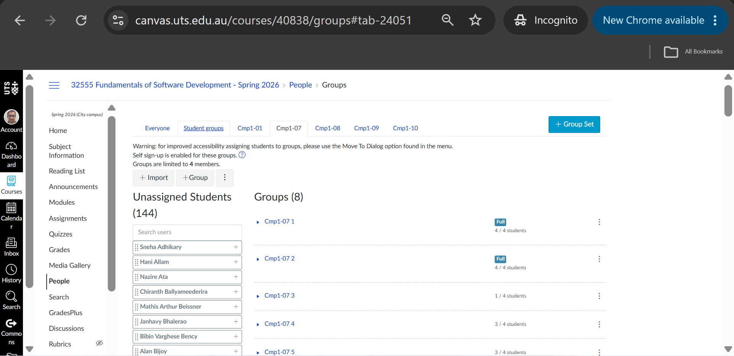
Have you attended your enrolled session?
Please attend the quiz during your enrolled session. Moving sessions will complicates the quiz set-up.
You can continue attending Cmp1# for labs and your project assignment.

Slide 5
Week 7 Outline
Lab 7

Slide 6
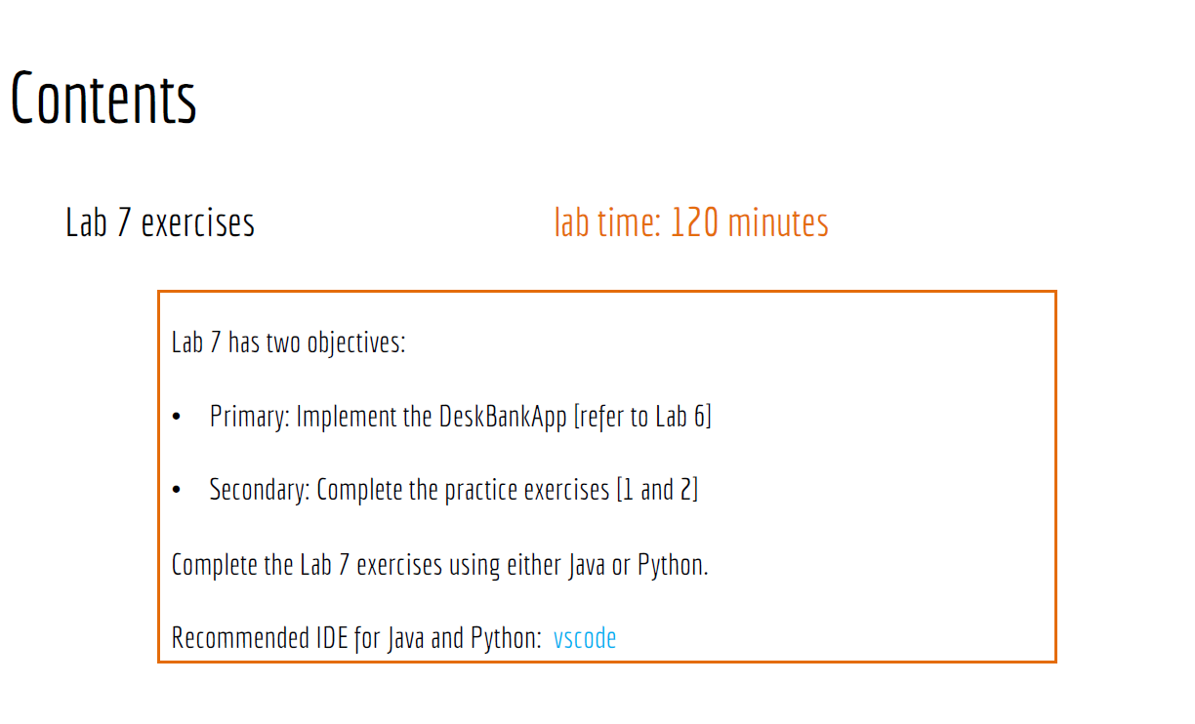
Lab 7

Slide 7
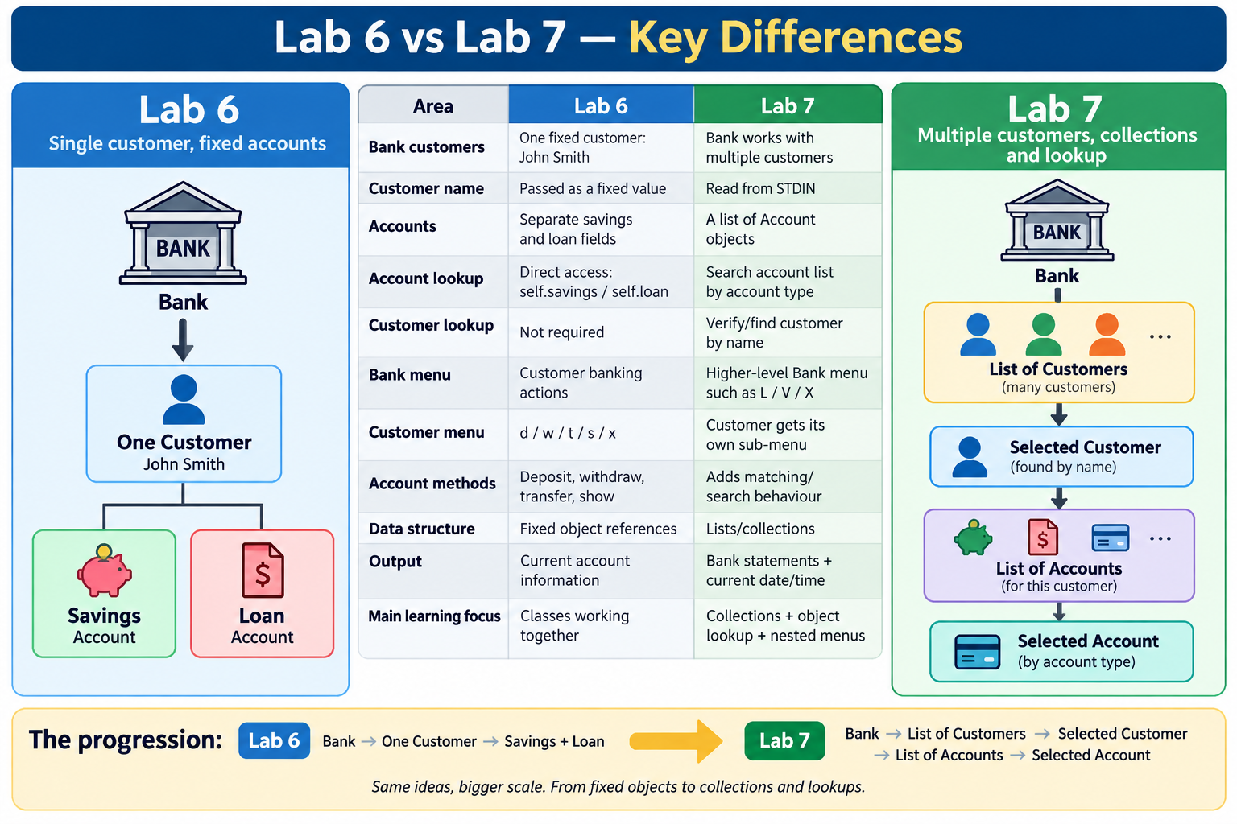

Slide 8
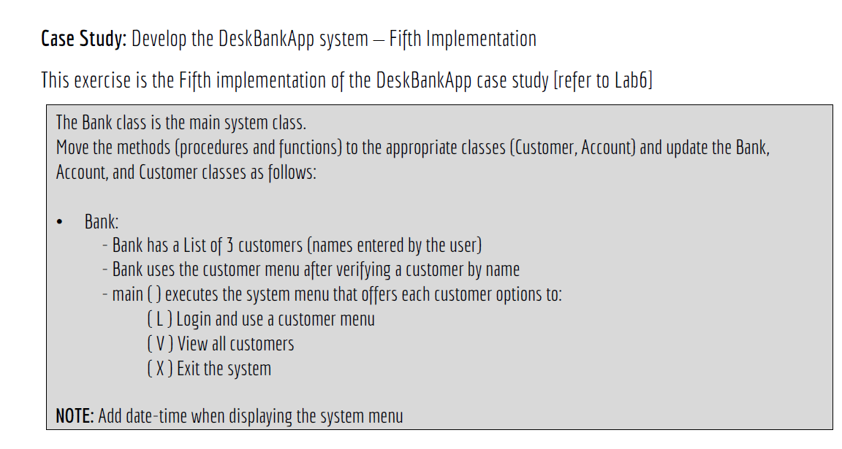
Lab 7

Slide 9
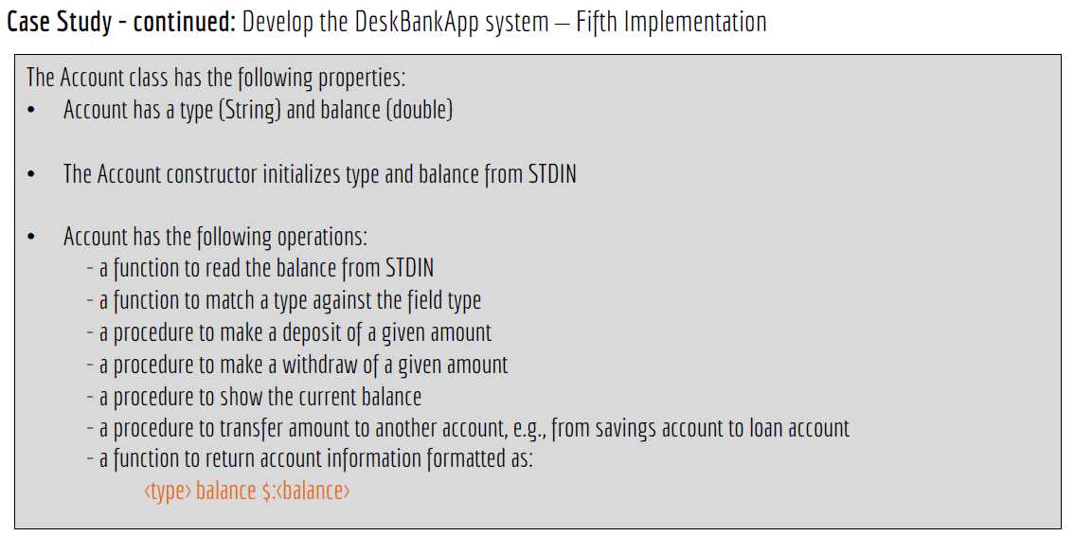
Lab 7

Slide 10
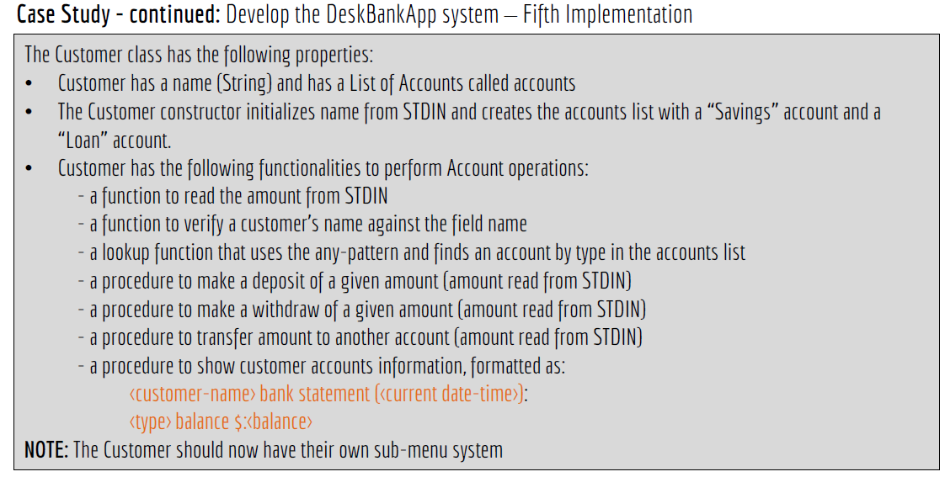
Lab 7

Slide 11
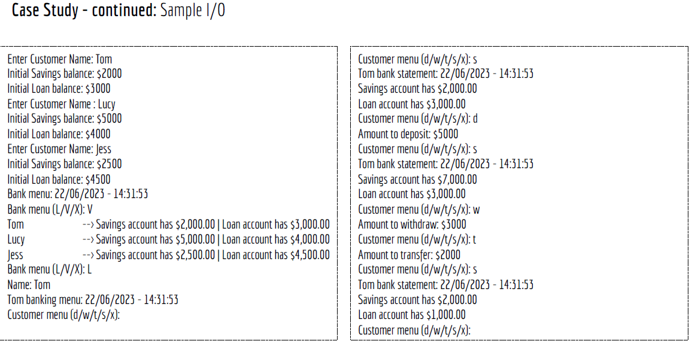
Lab 7

Slide 12
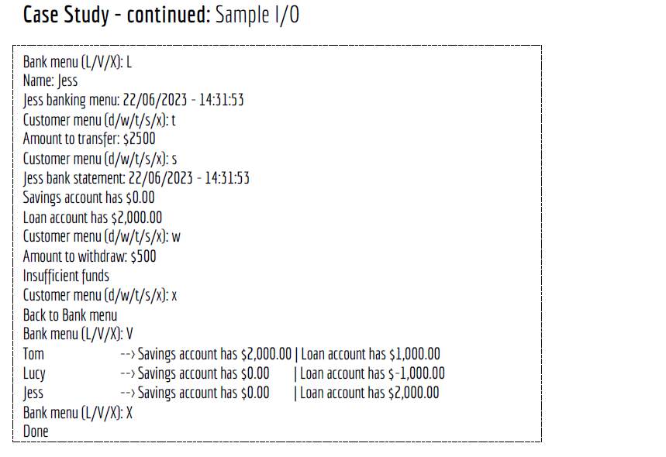
Lab 7

Slide 13
Lab 7 DeskBankApp — Fifth Implementation
Step 1 — Understand the new design
In Lab 6, the Customer had:
name
savings
loan
In Lab 7, Customer now has:
name
accounts
where: accounts = [Savings Account, Loan Account]

Slide 14
So instead of:
self.savings
self.loan
we start moving toward:
self.accounts
This makes the design more flexible.

Slide 15
Step 2 — Update the Account class
According to the Lab 7 slide, Account has:
type
balance
and methods to:
read balance
match account type
deposit
withdraw
show balance
transfer
return formatted account information

Slide 16
Python
2.1 Basic Account structure
class Account:
def __init__(self, account_type):
self.type = account_type
self.balance = self.read_balance()

Slide 17
2.2 Read balance
def read_balance(self):
return float(
input(
f"Initial {self.type} balance: $"
)
)

Slide 18
2.3 Match account type
def matches(self, target_type):
return self.type.lower() == target_type.lower()
Simple meaning:
Return True if this account has the requested type.
Example:
savings.matches("Savings")
returns:
True

Slide 19
2.4 Deposit
def deposit(self, amount):
self.balance += amount
2.5 Check funds
def has(self, amount):
return self.balance >= amount

Slide 20
2.6 Withdraw
def withdraw(self, amount):
if not self.has(amount):
raise ValueError("Insufficient funds")
self.balance -= amount
2.7 Transfer
The Lab 7 sample continues the earlier interpretation where transferring from Savings to Loan reduces both balances.
def transfer(self, amount, other_account):
if not self.has(amount):
raise ValueError("Insufficient funds")
self.withdraw(amount)
other_account.withdraw(amount)

Slide 21
2.8 Return account information
def __str__(self):
return (
f"{self.type} account has "
f"${self.balance:,.2f}"
)

Slide 22
Completed Python Account class
class Account:
def __init__(self, account_type):
self.type = account_type
self.balance = self.read_balance()
def read_balance(self):
return float(
input(
f"Initial {self.type} balance: $"
)
)
def matches(self, target_type):
return (
self.type.lower()
== target_type.lower()
)
def deposit(self, amount):
self.balance += amount
def has(self, amount):
return self.balance >= amount

Slide 23
def withdraw(self, amount):
if not self.has(amount):
raise ValueError(
"Insufficient funds"
)
self.balance -= amount
def transfer(
self,
amount,
other_account):
if not self.has(amount):
raise ValueError(
"Insufficient funds"
)
self.withdraw(amount)
other_account.withdraw(amount)
def __str__(self):
return (
f"{self.type} account has "
f"${self.balance:,.2f}"
)

Slide 24
Java Account class
2.1 Fields
private String type;
private double balance;
2.2 Constructor
public Account(
String type,
Scanner input) {
this.type = type;
this.balance =
readBalance(input);
}

Slide 25
2.3 Match type
public boolean matches(
String targetType) {
return type.equalsIgnoreCase(
targetType
);
}

Slide 26
2.4 Deposit
public void deposit(
double amount) {
balance += amount;
}
2.5 Has enough funds
public boolean has(
double amount) {
return balance >= amount;
}

Slide 27
2.6 Withdraw
public void withdraw(
double amount) {
if (!has(amount)) {
throw new IllegalArgumentException(
"Insufficient funds"
);
}
balance -= amount;
}

Slide 28
2.7 Transfer
public void transfer(
double amount,
Account otherAccount) {
if (!has(amount)) {
throw new IllegalArgumentException(
"Insufficient funds"
);
}
withdraw(amount);
otherAccount.withdraw(amount);
}

Slide 29
Completed Java Account.java
import java.util.Scanner;
public class Account {
private String type;
private double balance;
public Account(
String type,
Scanner input) {
this.type = type;
this.balance =
readBalance(input);
}
private double readBalance(
Scanner input) {
System.out.print(
"Initial "
+ type
+ " balance: $"
);
return input.nextDouble();
}
public boolean matches(
String targetType) {
return type.equalsIgnoreCase(
targetType
);
}

Slide 30
public void deposit(
double amount) {
balance += amount;
}
public boolean has(
double amount) {
return balance >= amount;
}
public void withdraw(
double amount) {
if (!has(amount)) {
throw new IllegalArgumentException(
"Insufficient funds"
);
}
balance -= amount;
}
public void transfer(
double amount,
Account otherAccount) {
if (!has(amount)) {
throw new IllegalArgumentException(
"Insufficient funds"
);
}
withdraw(amount);
otherAccount.withdraw(amount);
}

Slide 31
@Override
public String toString() {
return String.format(
"%s account has $%,.2f",
type,
balance
);
}
}

Slide 32
Step 3 — Update Customer to use a list of Accounts
The important new Lab 7 concept is:
Customer → List<Account>
instead of:
Customer
├ savings
└── loan

Slide 33
Python
3.1 Create Customer
class Customer:
def __init__(self):
self.name = input(
"Enter Customer Name: "
)
self.accounts = [
Account("Savings"),
Account("Loan")
]

Slide 34
3.2 Verify a customer's name
def matches(self, target_name):
return (
self.name.lower()
== target_name.lower()
)

Slide 35
3.3 Find an account using a search pattern
def account(self, account_type):
return next(
(
account
for account in self.accounts
if account.matches(
account_type
)
),
None
)
This is the Python equivalent of the slide's any-pattern idea.
Simpler explanation:
Search the list and return the first account whose type matches.

Slide 36
For beginners, this loop is even easier:
def account(self, account_type):
for account in self.accounts:
if account.matches(
account_type):
return account
return None
I would teach this simpler version first.

Slide 37
3.4 Read amount
def read_amount(self, message):
return float(
input(message)
)

Slide 38
3.5 Deposit into Savings
def deposit(self):
amount = self.read_amount(
"Amount to deposit: $"
)
savings = self.account(
"Savings"
)
savings.deposit(amount)

Slide 39
3.6 Withdraw
def withdraw(self):
amount = self.read_amount(
"Amount to withdraw: $"
)
savings = self.account(
"Savings"
)
try:
savings.withdraw(amount)
except ValueError as error:
print(error)

Slide 40
3.7 Transfer
def transfer(self):
amount = self.read_amount("Amount to transfer: $")
savings = self.account("Savings")
loan = self.account("Loan")
try:
savings.transfer(amount, loan)
except ValueError as error:
print(error)

Slide 41
Step 4 — Add current date and time
The Lab 7 output includes:
Tom bank statement: 22/06/2023 - 14:31:53
Python
from datetime import datetime
Then:
now = datetime.now()
formatted_time = now.strftime("%d/%m/%Y - %H:%M:%S“)

Slide 42
Java
import java.time.LocalDateTime;
import java.time.format.DateTimeFormatter;
Then:
DateTimeFormatter formatter =
DateTimeFormatter.ofPattern("dd/MM/yyyy - HH:mm:ss");
String now =
LocalDateTime.now()
.format(formatter);

Slide 43
Step 5 — Show customer statement
Python
def show(self):
from datetime import datetime
now = datetime.now().strftime("%d/%m/%Y - %H:%M:%S")
print(
f"{self.name} bank statement: "
f"{now}"
)
for account in self.accounts:
print(account)

Slide 44
Example:
Tom bank statement: 22/06/2023 - 14:31:53
Savings account has $2,000.00
Loan account has $3,000.00
Step 6 — Give Customer its own sub-menu
This is explicitly stated in the Lab 7 slide.
d = deposit
w = withdraw
t = transfer
s = show
x = back to Bank menu

Slide 45
Python
def menu(self):
while True:
choice = input(
"Customer menu "
"(d/w/t/s/x): "
).lower()
if choice == "d":
self.deposit()
elif choice == "w":
self.withdraw()
elif choice == "t":
self.transfer()
elif choice == "s":
self.show()
elif choice == "x":
print("Back to Bank menu")
break

Slide 46
Completed Python Customer class
from datetime import datetime
class Customer:
def __init__(self):
self.name = input(
"Enter Customer Name: "
)
self.accounts = [
Account("Savings"),
Account("Loan")
]
def matches(
self,
target_name):
return (
self.name.lower()
== target_name.lower()
)
def account(
self,
account_type):
for account in self.accounts:

Slide 47
if account.matches(
account_type):
return account
return None
def read_amount(
self,
message):
return float(
input(message)
)
def deposit(self):
amount = self.read_amount(
"Amount to deposit: $"
)
savings = self.account(
"Savings"
)
savings.deposit(amount)
def withdraw(self):
amount = self.read_amount(
"Amount to withdraw: $"
)

Slide 48
savings = self.account(
"Savings"
)
try:
savings.withdraw(amount)
except ValueError as error:
print(error)
def transfer(self):
amount = self.read_amount(
"Amount to transfer: $"
)
savings = self.account(
"Savings"
)
loan = self.account(
"Loan"
)
try:
savings.transfer(
amount,
loan
)

Slide 49
except ValueError as error:
print(error)
def show(self):
now = datetime.now().strftime(
"%d/%m/%Y - %H:%M:%S"
)
print(
f"{self.name} "
f"bank statement: {now}"
)
for account in self.accounts:
print(account)
def menu(self):
while True:
choice = input(
"Customer menu "
"(d/w/t/s/x): "
).lower()
if choice == "d":
self.deposit()

Slide 50
elif choice == "w":
self.withdraw()
elif choice == "t":
self.transfer()
elif choice == "s":
self.show()
elif choice == "x":
print(
"Back to Bank menu"
)
break

Slide 51
Step 7 — Bank now manages multiple customers
The sample clearly shows:
Tom
Lucy
Jess
So the Bank needs a collection of customers.
Python
class Bank:
def __init__(self):
self.customers = []

Slide 52
Add customers
For the sample, three are created:
for i in range(3):
self.customers.append(Customer())
Look up a customer by name
def customer(self, name):
for customer in self.customers:
if customer.matches(name):
return customer
return None

Slide 53
Step 8 — Bank view()
The sample displays all customers:
Tom --> Savings ... | Loan ...
Lucy --> Savings ... | Loan ...
Jess --> Savings ... | Loan ...
Python
def view(self):
for customer in self.customers:
savings = customer.account("Savings")
loan = customer.account("Loan")
print(
f"{customer.name:<10}"
f" --> {savings} | {loan}"
)

Slide 54
Step 9 — Bank login/select customer
The sample uses:
Bank menu (L/V/X): L
Name: Tom
So:
def login(self):
name = input("Name: ")
customer = self.customer(name)
if customer is None:
print("Customer does not exist")
return
customer.menu()

Slide 55
Step 10 — Bank menu
def menu(self):
while True:
choice = input("Bank menu (L/V/X): ").upper()
if choice == "L":
self.login()
elif choice == "V":
self.view()
elif choice == "X":
print("Done")
break

Slide 56
Completed Python Bank class
class Bank:
def __init__(self):
self.customers = []
for i in range(3):
self.customers.append(
Customer()
)
def customer(
self,
name):
for customer in self.customers:
if customer.matches(
name):
return customer

Slide 57
return None
def view(self):
for customer in self.customers:
savings = customer.account(
"Savings"
)
loan = customer.account(
"Loan"
)

Slide 58
print(
f"{customer.name:<10}"
f" --> "
f"{savings} | {loan}"
)
def login(self):
name = input(
"Name: "
)
customer = self.customer(
name
)

Slide 59
if customer is None:
print(
"Customer does not exist"
)
return
customer.menu()
def menu(self):
while True:

Slide 60
choice = input(
"Bank menu "
"(L/V/X): "
).upper()
if choice == "L":
self.login()
elif choice == "V":
self.view()
elif choice == "X":

Slide 61
print("Done")
break
def main():
bank = Bank()
bank.menu()
if __name__ == "__main__":
main()

Slide 62
Java Customer — Key Changes
The most important Java change is:
private ArrayList<Account> accounts;
instead of separate:
private Account savings;
private Account loan;
Initialize:
accounts =
new ArrayList<>();
accounts.add(
new Account(
"Savings",
input
)
);

Slide 63
accounts.add(
new Account(
"Loan",
input
)
);
Lookup:
public Account account(
String type) {
for (Account account : accounts) {
if (account.matches(type)) {
return account;
}
}

Slide 64
return null;
}
Java Bank — Multiple Customers
private ArrayList<Customer> customers;
Initialize:
customers =
new ArrayList<>();
for (int i = 0; i < 3; i++) {
customers.add(
new Customer(input)
);
}

Slide 65
Lookup:
public Customer customer(
String name) {
for (
Customer customer
: customers
) {
if (customer.matches(name)) {
return customer;
}
}
return null;
}
This is the Java equivalent of searching the list.

Slide 66
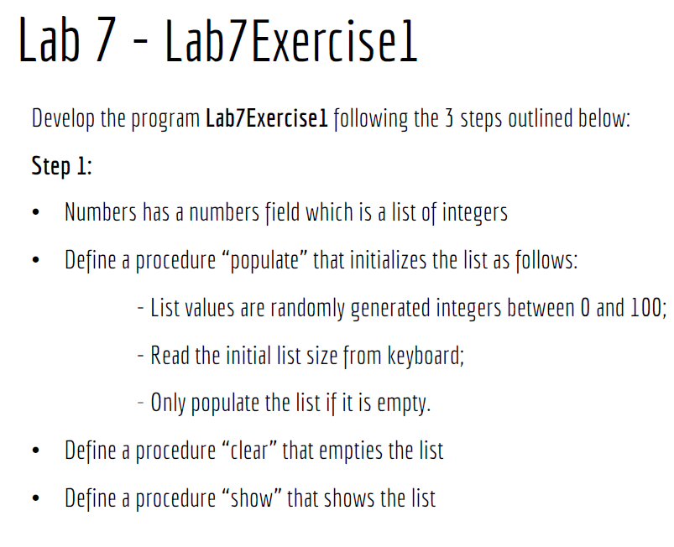
Lab 7

Slide 67
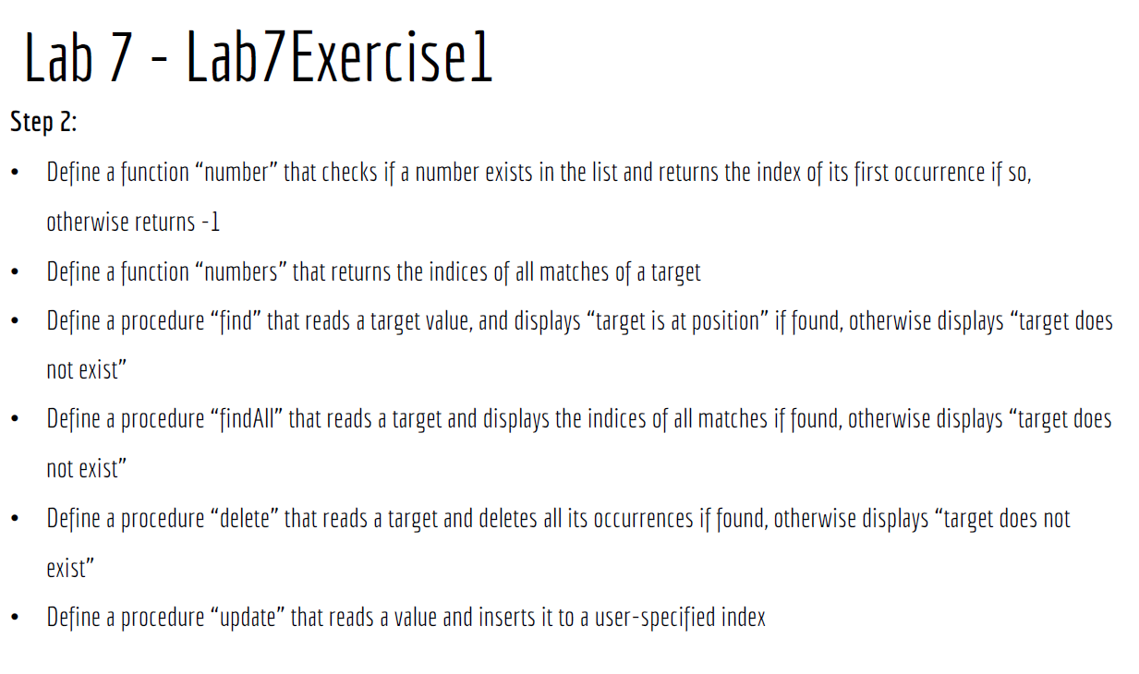
Lab 7

Slide 68
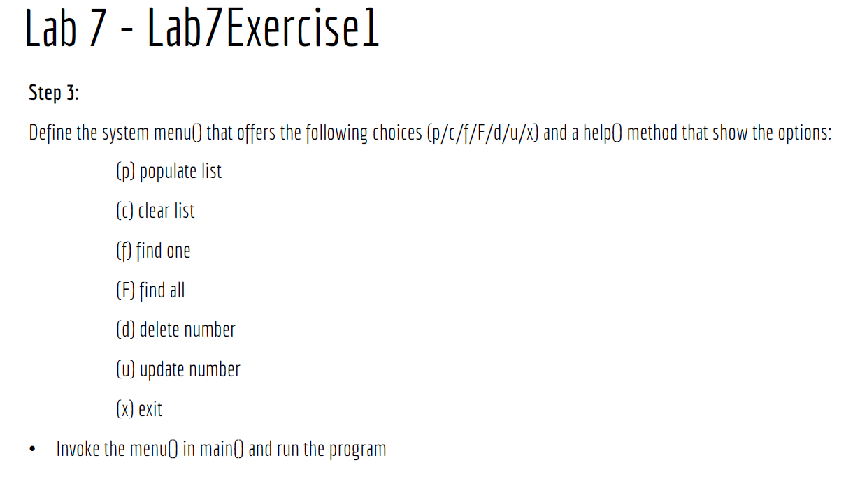
Lab 7

Slide 69
Lab 7 Exercise 1 — Numbers List
This exercise focuses on lists, searching, deleting, updating, and menus.
Step 1 — Create Numbers
Python
class Numbers:
def __init__(self):
self.numbers = []
Java
Use an ArrayList<Integer> because the list needs to grow, shrink, and delete elements.
private ArrayList<Integer> numbers;
Initialize:
numbers =
new ArrayList<>();

Slide 70
Step 2 — populate()
Requirements:
read list size
generate random integers 0–100
only populate if list is empty
Python
def populate(self):
if self.numbers:
print(
"List is not empty"
)
return
size = int(
input("List size: ")
)
import random
for i in range(size):

Slide 71
self.numbers.append(
random.randint(
0,
100
)
)

Slide 72
Java
public void populate(
Scanner input) {
if (!numbers.isEmpty()) {
System.out.println(
"List is not empty"
);
return;
}
System.out.print(
"List size: "
);

Slide 73
int size =
input.nextInt();
Random random =
new Random();
for (
int i = 0;
i < size;
i++
) {
numbers.add(
random.nextInt(101)
);
}
}

Slide 74
Step 3 — clear()
Python
def clear(self):
self.numbers.clear()
Java
public void clear() {
numbers.clear();
}

Slide 75
Step 4 — show()
Python
def show(self):
print(self.numbers)
Java
public void show() {
System.out.println(
numbers
);
}

Slide 76
Step 5 — number(target)
Return index of first match, otherwise -1.
Python
def number(
self,
target):
for index, value in enumerate(
self.numbers):
if value == target:
return index
return -1
Java
public int number(
int target) {
return numbers.indexOf(
target
);
}
indexOf() already returns -1 if not found.

Slide 77
Step 6 — numbers(target)
Return all matching indices.
Python
def numbers_at(
self,
target):
matches = []
for index, value in enumerate(
self.numbers):
if value == target:
matches.append(index)
return matches
I use numbers_at() rather than numbers() in Python because self.numbers is already the field name.

Slide 78
Java
public ArrayList<Integer> numbers(
int target) {
ArrayList<Integer> matches =
new ArrayList<>();
for (
int i = 0;
i < numbers.size();
i++
) {
if (
numbers.get(i)
== target
) {
matches.add(i);
}
}
return matches;
}

Slide 79
Step 7 — find()
Python
def find(self):
target = int(
input("Target: ")
)
position = self.number(
target
)
if position == -1:
print(
f"{target} does not exist"
)
else:
print(
f"{target} is at position "
f"{position}"
)

Slide 80
Step 8 — findAll()
Python
def find_all(self):
target = int(
input("Target: ")
)
positions = self.numbers_at(
target
)
if not positions:
print(
f"{target} does not exist"
)
else:
print(
f"{target} is at positions "
f"{positions}"
)

Slide 81
Step 9 — delete()
Delete all occurrences.
Python
def delete(self):
target = int(
input("Target: ")
)
if target not in self.numbers:
print(
f"{target} does not exist"
)
return
self.numbers = [
value
for value in self.numbers
if value != target
]

Slide 82
Java
A safe approach:
numbers.removeIf(
value -> value == target
);
But first check if it exists.

Slide 83
Step 10 — update()
The slide says:
reads a value and inserts it to a user-specified index
That means insert, not replace.
Python
def update(self):
value = int(
input("Value: ")
)
index = int(
input("Index: ")
)
if (
index < 0
or index > len(
self.numbers
)
):
print("Invalid index")
return
self.numbers.insert(
index,
value
)
Java
numbers.add(
index,
value
);
Again, this inserts and shifts later values.

Slide 84
Step 11 — help()
def help(self):
print("p = populate list")
print("c = clear list")
print("f = find one")
print("F = find all")
print("d = delete number")
print("u = update number")
print("s = show list")
print("x = exit")
The slide's menu line does not visibly list s, even though Step 1 requires a show() method. I would include s = show list because otherwise students have no menu option for it. If the coordinator expects exactly p/c/f/F/d/u/x, then show() could simply be called after operations instead.

Slide 85
Step 12 — menu()
Python
def menu(self):
while True:
choice = input(
"Menu "
"(p/c/f/F/d/u/s/x): "
)
if choice == "p":
self.populate()
elif choice == "c":
self.clear()
elif choice == "f":
self.find()
elif choice == "F":
self.find_all()
elif choice == "d":
self.delete()
elif choice == "u":

Slide 86
self.update()
elif choice == "s":
self.show()
elif choice == "x":
break
else:
self.help()

Slide 87
Completed Python — Lab7Exercise1
import random
class Numbers:
def __init__(self):
self.numbers = []
def populate(self):
if self.numbers:
print("List is not empty")
return
size = int(
input("List size: ")
)
for i in range(size):
self.numbers.append(
random.randint(
0,
100
)
)
def clear(self):
self.numbers.clear()

Slide 88
def show(self):
print(self.numbers)
def number(
self,
target):
for index, value in enumerate(
self.numbers):
if value == target:
return index
return -1
def numbers_at(
self,
target):
matches = []
for index, value in enumerate(
self.numbers):
if value == target:
matches.append(index)
return matches

Slide 89
def find(self):
target = int(
input("Target: ")
)
position = self.number(
target
)
if position == -1:
print(
f"{target} does not exist"
)
else:
print(
f"{target} is at position "
f"{position}"
)
def find_all(self):
target = int(
input("Target: ")
)

Slide 90
positions = self.numbers_at(
target
)
if not positions:
print(
f"{target} does not exist"
)
else:
print(
f"{target} is at positions "
f"{positions}"
)
def delete(self):
target = int(
input("Target: ")
)
if target not in self.numbers:
print(
f"{target} does not exist"
)
return

Slide 91
self.numbers = [
value
for value in self.numbers
if value != target
]
def update(self):
value = int(
input("Value: ")
)
index = int(
input("Index: ")
)
if (
index < 0
or index > len(
self.numbers
)
):
print("Invalid index")
return
self.numbers.insert(
index,
value
)

Slide 92
def help(self):
print("p = populate list")
print("c = clear list")
print("f = find one")
print("F = find all")
print("d = delete number")
print("u = update number")
print("s = show list")
print("x = exit")
def menu(self):
while True:
choice = input(
"Menu "
"(p/c/f/F/d/u/s/x): "
)
if choice == "p":
self.populate()
elif choice == "c":
self.clear()
elif choice == "f":
self.find()
elif choice == "F":
self.find_all()

Slide 93
elif choice == "d":
self.delete()
elif choice == "u":
self.update()
elif choice == "s":
self.show()
elif choice == "x":
break
else:
self.help()
def main():
numbers = Numbers()
numbers.menu()
if __name__ == "__main__":
main()

Slide 94
Completed Java — Lab7Exercise1
import java.util.ArrayList;
import java.util.Random;
import java.util.Scanner;
public class Lab7Exercise1 {
private ArrayList<Integer> numbers;
public Lab7Exercise1() {
numbers =
new ArrayList<>();
}
public void populate(
Scanner input) {
if (!numbers.isEmpty()) {
System.out.println(
"List is not empty"
);

Slide 95
return;
}
System.out.print(
"List size: "
);
int size =
input.nextInt();
Random random =
new Random();
for (
int i = 0;
i < size;
i++
) {
numbers.add(
random.nextInt(101)
);
}
}

Slide 96
public void clear() {
numbers.clear();
}
public void show() {
System.out.println(
numbers
);
}
public int number(
int target) {
return numbers.indexOf(
target
);
}
public ArrayList<Integer> numbers(
int target) {

Slide 97
ArrayList<Integer> matches =
new ArrayList<>();
for (
int i = 0;
i < numbers.size();
i++
) {
if (
numbers.get(i)
== target
) {
matches.add(i);
}
}
return matches;
}
public void find(
Scanner input) {

Slide 98
System.out.print(
"Target: "
);
int target =
input.nextInt();
int position =
number(target);
if (position == -1) {
System.out.println(
target
+ " does not exist"
);
} else {
System.out.println(
target
+ " is at position "
+ position
);
}
}

Slide 99
public void findAll(
Scanner input) {
System.out.print(
"Target: "
);
int target =
input.nextInt();
ArrayList<Integer> positions =
numbers(target);
if (positions.isEmpty()) {
System.out.println(
target
+ " does not exist"
);
} else {

Slide 100
System.out.println(
target
+ " is at positions "
+ positions
);
}
}
public void delete(
Scanner input) {
System.out.print(
"Target: "
);
int target =
input.nextInt();
if (!numbers.contains(target)) {
System.out.println(
target
+ " does not exist"
);

Slide 101
return;
}
numbers.removeIf(
value ->
value == target
);
}
public void update(
Scanner input) {
System.out.print(
"Value: "
);
int value =
input.nextInt();
System.out.print(
"Index: "
);

Slide 102
int index =
input.nextInt();
if (
index < 0
|| index > numbers.size()
) {
System.out.println(
"Invalid index"
);
return;
}
numbers.add(
index,
value
);
}

Slide 103
public void help() {
System.out.println(
"p = populate list"
);
System.out.println(
"c = clear list"
);
System.out.println(
"f = find one"
);
System.out.println(
"F = find all"
);
System.out.println(
"d = delete number"
);
System.out.println(
"u = update number"
);

Slide 104
System.out.println(
"s = show list"
);
System.out.println(
"x = exit"
);
}
public void menu(
Scanner input) {
while (true) {
System.out.print(
"Menu "
+ "(p/c/f/F/d/u/s/x): "
);
String choice =
input.next();
switch (choice) {

Slide 105
case "p":
populate(input);
break;
case "c":
clear();
break;
case "f":
find(input);
break;
case "F":
findAll(input);
break;
case "d":
delete(input);
break;
case "u":
update(input);
break;

Slide 106
case "s":
show();
break;
case "x":
return;
default:
help();
}
}
}
public static void main(
String[] args) {
Scanner input =
new Scanner(System.in);
Lab7Exercise1 program =
new Lab7Exercise1();
program.menu(input);
input.close();
}
}

Slide 107
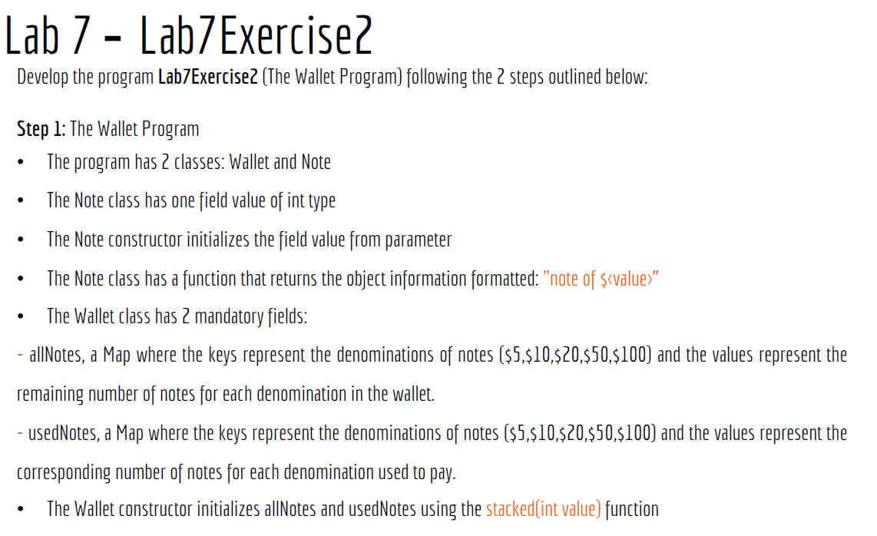
Lab 7

Slide 108
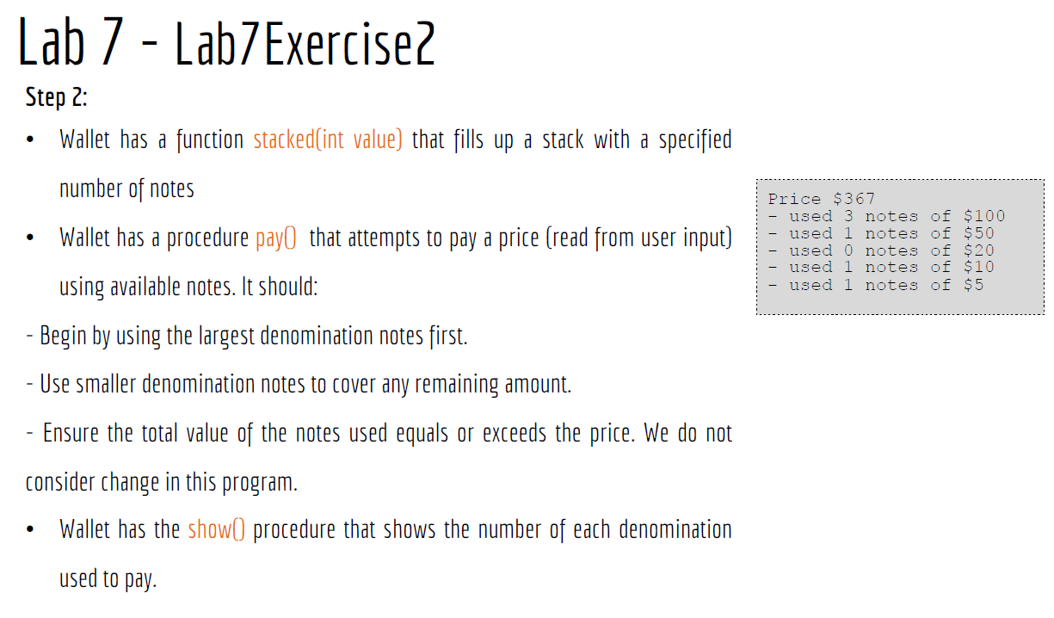
Lab 7

Slide 109

Happy Learning and Bright Futures Ahead! Dr. Farshid Keivanian Stay Connected: linkedin.com/in/farshid-keivanian github.com/FarshidKeivanian
Education is the most powerful weapon you can use to change the world. — Nelson Mandela

